Slide 1
Docker Swarm and Kubernetes in cloud computing environment presented by: Kamalaksha NC

Slide 2
Abstract
The main ambition is work balancing, which means to balance the work on each and every node in Docker Swarm and comparing the performance of the Docker Swarm with the Kubernetes.
Container orchestration is fast evolving, Docker Swarm and Kubernetes are the two major technologies used and firmly cemented their position in the Docker ecosystem.
Developers love using Docker Swarm because it leverages the power of containers, helps guarantee high service availability and reduces time consuming.

Slide 3
Contents
Introduction
Existing System
Problem Statement
Proposed System
Methodology
Experimental results
Conclusion

Slide 4
1.Introduction
In the early days, software applications were designed and deployed as monolithic applications.
Cloud computing platforms offered the physical hardware resources required to run the applications as a service.
Microservice architectures applications are further broken up into various discrete services that are each packaged in a separate container.
The first key innovation, that became an integral part of the solution to handle the deployment of distributed applications on the cloud was Containerization.

Slide 5
2. Existing System
Docker are now been used for package applications so that they can access a specific set of resources on a physical or virtual host’s operating system.
But scalability is an operational challenge when we have more containers

Slide 6
3. Problem Statement
Although the Microservices style solved most of the problems with monolithic on-premises applications, it introduced new challenges.
Tracking all the containers and information of all the containers whenever there are 100’s containers .
Load Balancing in all Containers.

Slide 7
4.Proposed System
Container orchestration tools provide a framework for managing containers and microservices architecture at scale.
container orchestration can greatly reduce the complexity in production as these tools are designed to resolve, like load balance allow upgrades of individual containers with no downtime.

Slide 8
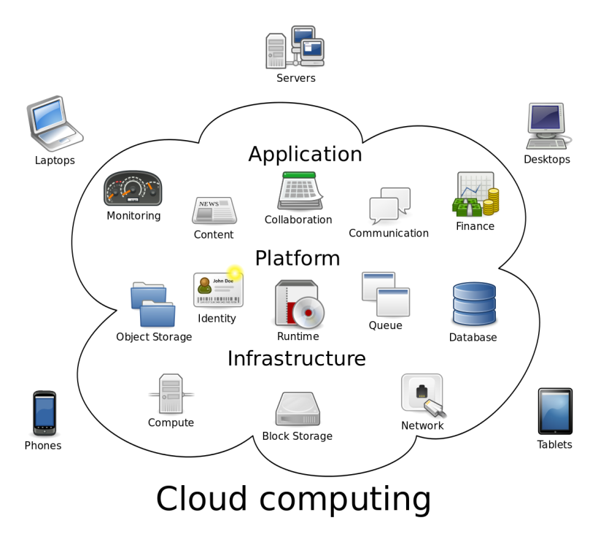
5.Methodolgy

Slide 9
Container Orchestration:
Container orchestration is the automatic process of managing or scheduling the work of individual containers for applications based on microservices within multiple clusters.
The widely deployed container orchestration platforms are
Docker Swarm
Kubernetes

Slide 10
Docker Swarm
Docker Swarm is a container orchestration tool part of Docker engine with it, developer and IT administration can deploy and manage a cluster of Docker nodes.

Slide 11
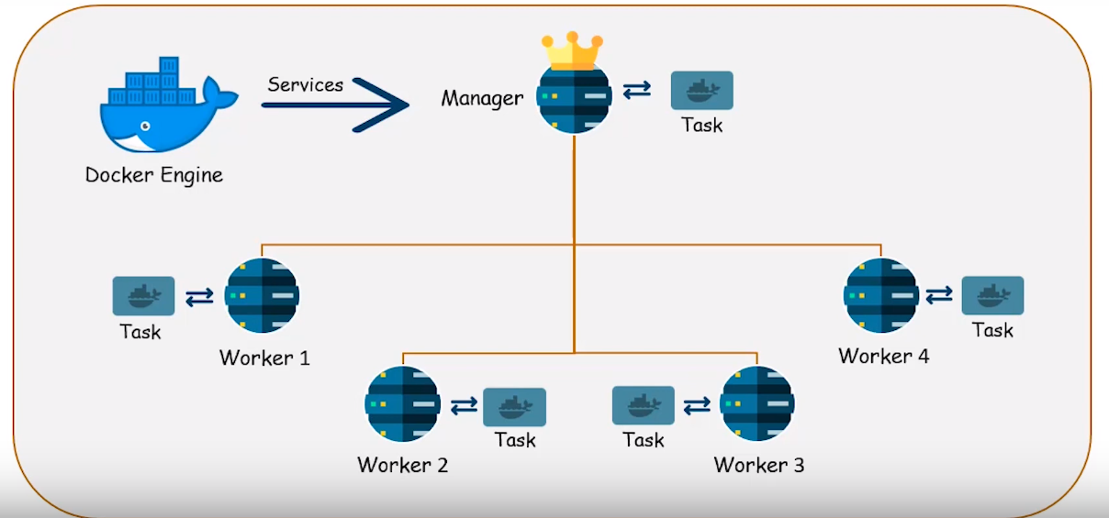
Docker Swarm Architecture

Slide 12
Kubernetes
Kubernetes (also known as k8s or kube) is an open source container orchestration platform that automates many of the manual processes involved in deploying, managing, and scaling containerized applications.

Slide 13
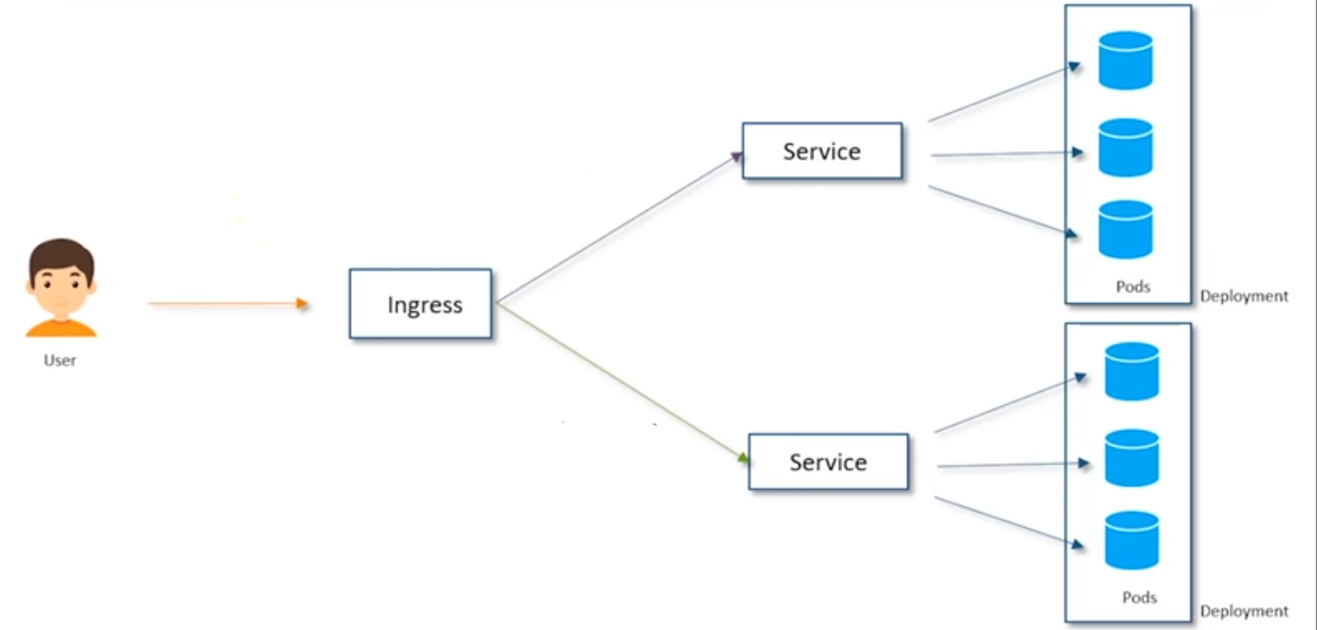
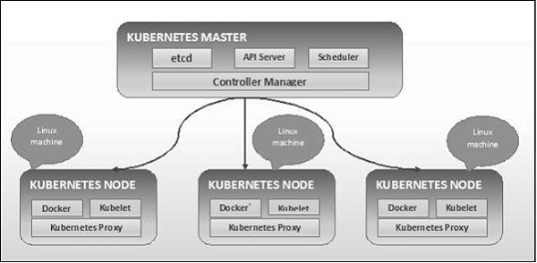
Kubernetes Architecture

Slide 14
6. Experimental Results swarm master node

Slide 15
Swarm worker node 1

Slide 16
7. Conclusion
Using the Technology docker, container and container orchestration which would be helpful everyone in terms of loadbalancing, allow upgrades of individual containers with no downtime.
further we had implemented the docker swarm and kubernetes in form of cluster and run the services on it and we got that kubernetes is superior than the docker swarm.

Slide 17
Thank you

